Slide 1

JQuery
I took these slides from the site because they were pretty good looking.
Notes:
Instructions for editing school and department titles:
Select from menu: View > Master > Slide Master
Click on each text area you wish to edit. Text will become editable.

Slide 2

JQuery
- A huge collection of predefined javascript objects and methods that are free to use and link to.
- Go to http://jquery.com/
- JQuery also provides a mobile library and a CSS library with predefined styles for fancy buttons, links, headings and fancy mobile interfaces (like the one here http://corythoma.com/index3.html :) ).
19 Oct 2009

Slide 3
Accessing JQuery
- Two ways to access it:
-Download it and reference:
<script src="jquery.js"></script>
(in the same directory)
-Reference the online page:
<script src="http://code.jquery.com/jquery-1.4.2.min.js"></script>
(Do this for class today)

Slide 4
How Does it Work?
-Much of Jquery relies on the structure of the HTML to operate:
-We can reference the type of code.
<p>some text</p>
<div> some other code</div>
<button>make a button </button>
By:
<script>
$(“div”).doSomeJquery();
</script>

Slide 5
How Does it Work? 2.0
-Or we can get specific:
-We can reference the type of code.
<p id = “p1”>some text</p>
<div id= “Frank”> some other code</div>
<button id = “Mildred”>make a button </button>
By:
<script>
$(id).doSomeJquery();
$(“Frank”).stuff();
</script>

Slide 6
Remember, it is just Javascript.
-It is nothing fancy, it is just a bunch of methods, objects, and variables (look at the document). We can use It just like we would any javascript:
<script src = jquery.js></script>
<script type = “text/javascript”>
var array = new Array();
var counter=0;
function onClick(id){
array[counter]=id;
counter+=1;
$(id).hide();//<is jquery
}
</script>

Slide 7
What can JQuery do for you?
-Make something easy that was otherwise hard. EX: Show and hide some html.
Compare:
demo3.html to demo4.html
-We can see how it makes life easier.
.toggle() goes from .hide() and .show(), which is much easier than
some css and complex statements in javascript.

Slide 8
Your Turn!
- I made a simple Q&A web page yourTurn.html.
-Your task is to make it so when the question is clicked, the answer toggles between hidden and not hidden.
Hint: No buttons or hyperlinks should be needed, and the .toggle is sufficient to accomplish this!!!

Slide 9
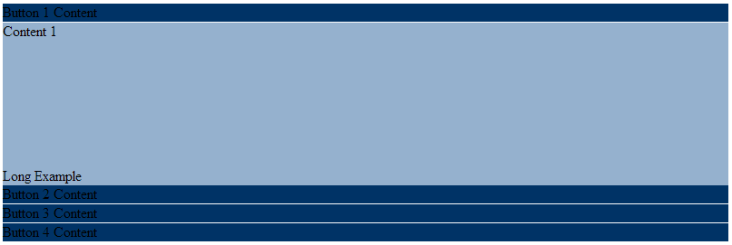
What else can we do?
We can make stuff animate:
Slide stuff from top, bottom, left, and right.
As an example, look at the accordion menu given in menu.html.

Slide 10

Ever Wonder?
-How to dynamically change some CSS with the click of a button?
-.addClass(arg). Changes all classes to arg.

Slide 11
Lame Animations
-Some people like the accordion menu, but are not sure how to do it. Jquery makes it easy with .slideDown() and .slideUp() and .is(“ :visable”).
Try to take what you did for the first part and instead of show/hide, make it slide up and down.

Slide 12
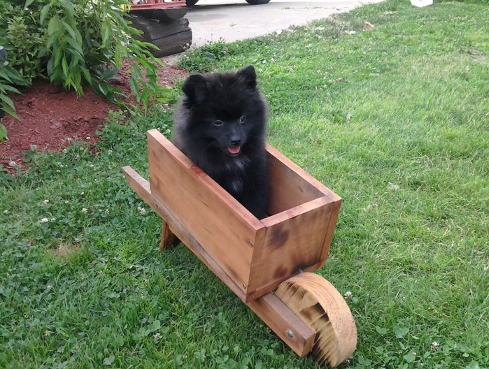
Not so lame animations.
-We are going to do this:
In javascript!!!

Slide 13
Your Turn.
Make some text, picture, table, or element do what animation.html does.
Use the API and Documentation to get the additional information you may need to complete this!

Slide 14
Real World Examples:
-weather.com
-corythoma.com/index3.html
-jquery.com
-espn.com
Bottom line: Jquery is useful to know!

